Slide 1


HR Attrition Analysis
Capstone Project

Slide 2

Content
Objective
Executive Summary and key findings
Data Summary and Pre-processing
Exploratory Data Analysis
Feature Engineering & Data Preparation
Hypothesis Testing
Predictive Modelling and Evaluation
Conclusion and Recommendation

Slide 3
Objective
Attrition in human resources refers to the gradual loss of employees over time. A major problem of higher employee attrition is its cost to an organization. The client company wants us to use their employee data and come with the insights and predictions that helps them to understand factors affecting employee attrition and plan their future workforce.

Slide 4
Executive Summary and Key findings
HR Attrition Analysis

Slide 5
Executive Summary and Key findings
The average years of an employee in the company is around 7 years.
No significant trend seen of overall Years at Company with Department and Job Role.
18% of Employees who leave the organization are with work experience less than two years.
41.2% of Employees work in this organization are from Life Sciences background followed by 31.6% employees from Medical background.

Slide 6
Executive Summary and Key findings
The Organization has given the most importance to Research and Development with 65.4% employees working in the department.
71.7% Employees tend to do/opting for Over Time in the organization.
Average pay for females is slightly higher than male.
65% of Employees in Sales Department tend to leave the organization which is 41% of total employee attrition.
On noticing the patterns, monetary are the factors mostly driving attrition. Followed by psychological features.

Slide 7
Data Summary and Pre-processing
HR Attrition Analysis

Slide 8
Data Summary and Pre-processing
We have used Case_study_1_Hr_attriton.xlsx ,sheet=1 for the analysis.
Total 2940 records/observations
31 variables of mixed datatypes
10 categorical variables and 21 continuous variables

Slide 9
Data Summary and Pre-processing
Missing Value Treatment: 49 missing values in Work Life Balance feature found. Treated by Simple Imputing with mean of the feature.
Categorical Features: 10 features found categorical and are converted into levels by Label Encoding.

Slide 10
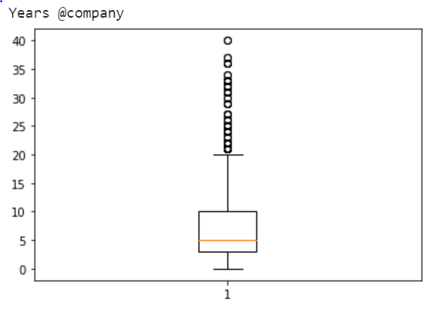
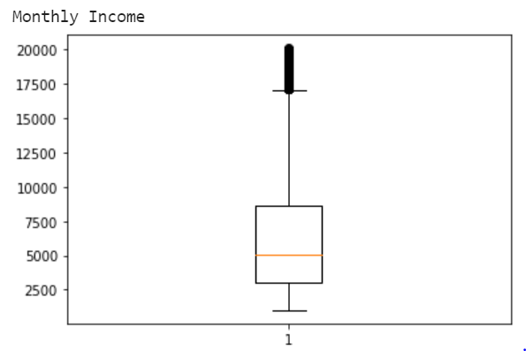
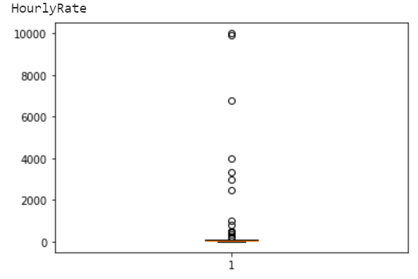
Data Summary and Pre-processing
Outlier Treatment

Slide 11
Data Summary and Pre-processing
Dropped features ‘Employee_ID’, ‘18Yrs’, ‘Standard hours’ as they provide no insight over the Target Variable.
Rounded the values imputed in Work Life Balance feature to the nearest integer.
Train and Test Split: All the three mutations of data are divided into Train and Test data sets in the ratio of 80:20.

Slide 12

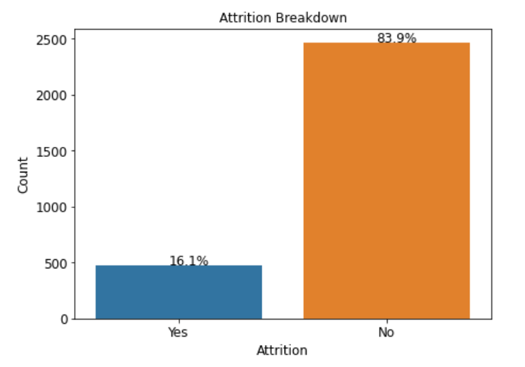
Target/Churn Definition
Our churn variable is the feature ‘Attrition’ on which the model will built on. Attrition is a categorical feature contains data of ‘Yes’ and ‘No ’ encoded into 1 and 0 respectively.
The bar graph shows that target variable is predominantly made of ‘No’.
16.12% Attrition happened.
Data is imbalanced

Slide 13
Variable | Meaning
Last_promotion_gsp | Years when last promotion Gsp Received
Years@Current Mangers | Number of years working under current Maneger
Education | Lastest Education pursued
EducationField | Fieldof education
Employee_ID | Employee Id in the organisation
Env_Satisfaction | Environment Satisfaction of the employee 1- Low,2-Medium,3-High,4-Very High
Gender | Gender of the Employee(Male /Female)
HourlyRate | Amount that the employee has been paid for an hour
Job_Involvement | Involvement of the employee in the job 1- Low,2-Medium,3-High,4-Very High
JobLevel | Level of Job Role in the Company 1:5 -> Lower level : Higher Level
JobRole | The Role of the employee in a perticular department
Job satisfac | Job Satisfaction of the employee 1- Low,2-Medium,3-High,4-Very High
Marital Status | Marital Status of the Employee(Married/Single/Divorced)
Monthly Income | Monthly Salary of the employee
Company Changed | No . Of companies employee has changed
18Yrs | Is the age of the employee 18Yrs above?(Y/N) [All employees are above 18]
Over Time | Whether the employee has done over time?(Yes/No)
PercentSalaryHike | Percentage of Salary Hiked of Employee
Performance Rating | Rating the Performance of the employee :1- Low,2-Medium,3-High,4-Very High
Relationship Satisfaction | Relationship Satisfaction of the employee 1- Low,2-Medium,3-High,4-Very High
Standard Hours | Standard hours is the number of hours of production time that should have been used during an accounting period
Stock Option Level | stock option Level is a type of equity compensation granted by company to their employees(0,1,2,3)
Total Working Years | Number of Years the employee has been working from
Training time spent | Number of months they have received training from the Company
Work LifeBalance | Work life Balance : 1-Bad,2-Good,3-Better,4-Best
Years @company | Number of Years of the employee assosiated with this Company
Years@Current role | Number of Years the employee has been working in the current role in this company
BusinessTravel | Travel History of the employee related to business: (Non-Travel, Travel-Frequently, Travel rarely)
Dept | The Department of the employee that is currently working in the company ( Human Resources , Research & Development ,Sales
Travel_distance | The travel Distance from Work place to Home of an employee
Attrition | Attrition of the employee(Yes/No)
Variable | Meaning
Last_promotion_gsp | Years when last promotion Gsp Received
Years@Current Mangers | Number of years working under current Maneger
Education | Lastest Education pursued
EducationField | Fieldof education
Employee_ID | Employee Id in the organisation
Env_Satisfaction | Environment Satisfaction of the employee 1- Low,2-Medium,3-High,4-Very High
Gender | Gender of the Employee(Male /Female)
HourlyRate | Amount that the employee has been paid for an hour
Job_Involvement | Involvement of the employee in the job 1- Low,2-Medium,3-High,4-Very High
JobLevel | Level of Job Role in the Company 1:5 -> Lower level : Higher Level
JobRole | The Role of the employee in a perticular department
Job satisfac | Job Satisfaction of the employee 1- Low,2-Medium,3-High,4-Very High
Marital Status | Marital Status of the Employee(Married/Single/Divorced)
Monthly Income | Monthly Salary of the employee
Company Changed | No . Of companies employee has changed
18Yrs | Is the age of the employee 18Yrs above?(Y/N) [All employees are above 18]
Over Time | Whether the employee has done over time?(Yes/No)
PercentSalaryHike | Percentage of Salary Hiked of Employee
Performance Rating | Rating the Performance of the employee :1- Low,2-Medium,3-High,4-Very High
Relationship Satisfaction | Relationship Satisfaction of the employee 1- Low,2-Medium,3-High,4-Very High
Standard Hours | Standard hours is the number of hours of production time that should have been used during an accounting period
Stock Option Level | stock option Level is a type of equity compensation granted by company to their employees(0,1,2,3)
Total Working Years | Number of Years the employee has been working from
Training time spent | Number of months they have received training from the Company
Work LifeBalance | Work life Balance : 1-Bad,2-Good,3-Better,4-Best
Years @company | Number of Years of the employee assosiated with this Company
Years@Current role | Number of Years the employee has been working in the current role in this company
BusinessTravel | Travel History of the employee related to business: (Non-Travel, Travel-Frequently, Travel rarely)
Dept | The Department of the employee that is currently working in the company ( Human Resources , Research & Development ,Sales
Travel_distance | The travel Distance from Work place to Home of an employee
Attrition | Attrition of the employee(Yes/No)

Slide 14
Exploratory Data Analysis
HR Attrition Analysis

Slide 15
Univariate Analysis Categorical Variables
HR Attrition Analysis

Slide 16
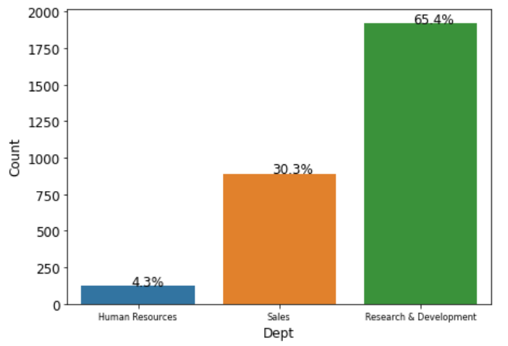
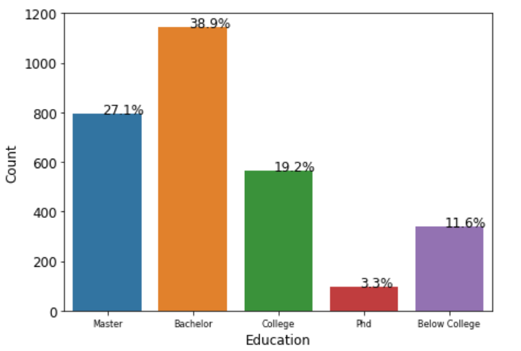
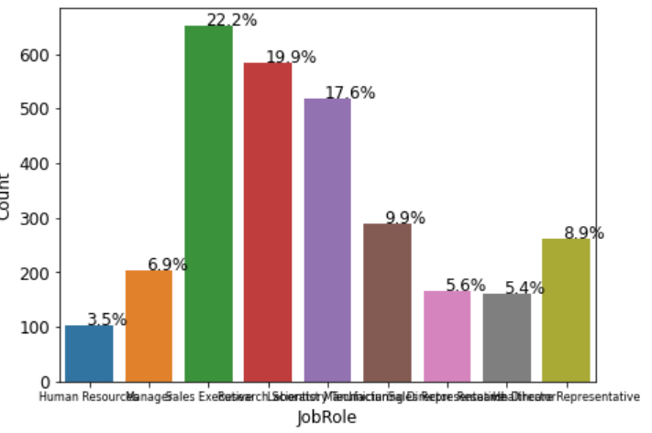
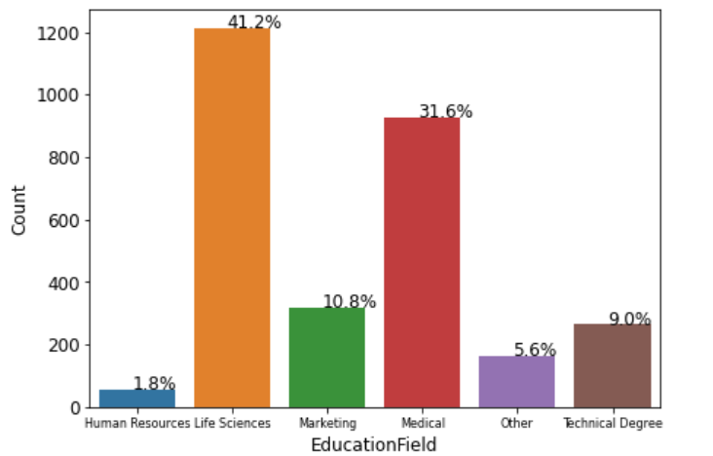

Slide 17
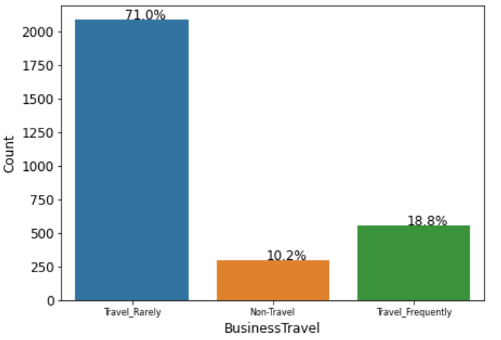
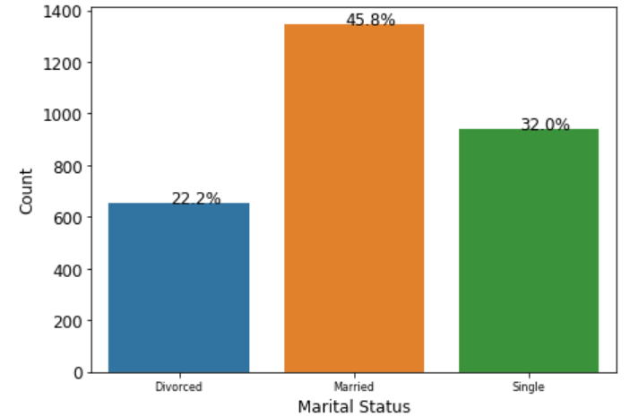
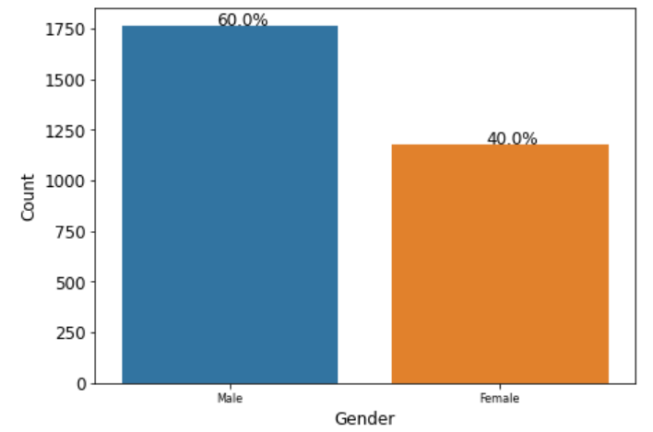
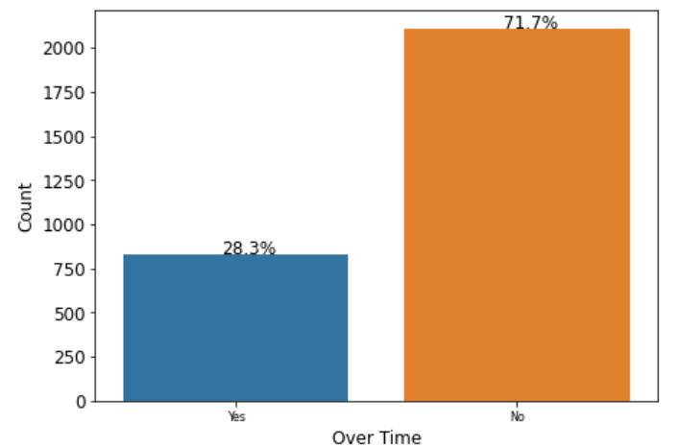

Slide 18
Bivariate Analysis
HR Attrition Analysis

Slide 19
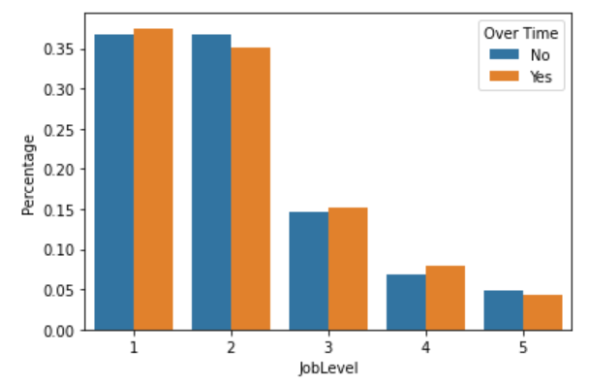
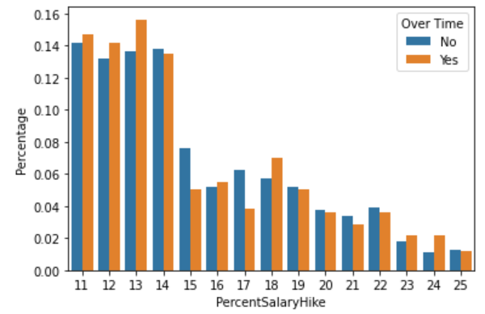
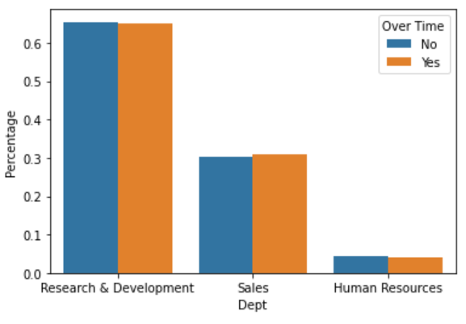
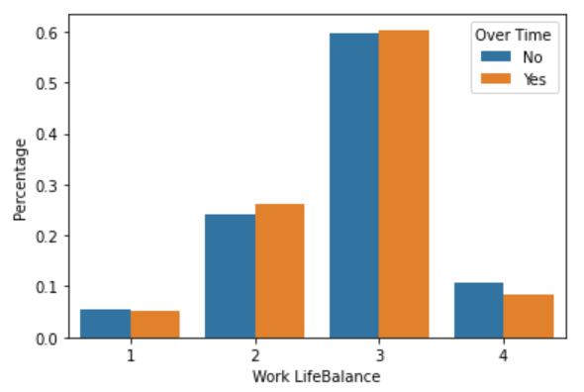
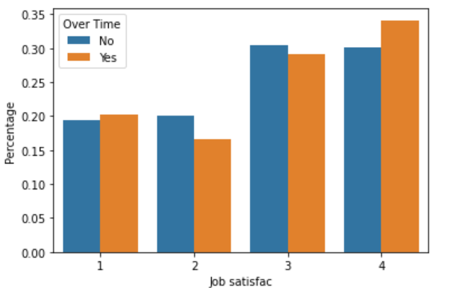
Over Time Analysis

Slide 20



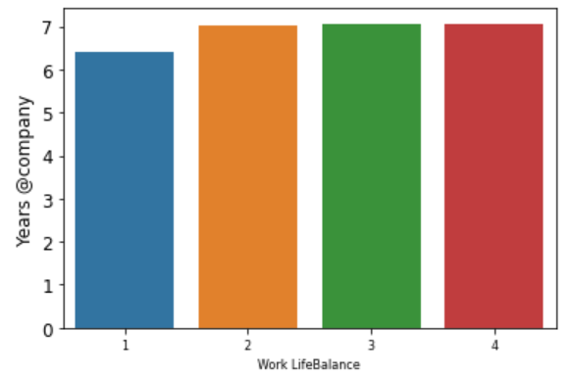
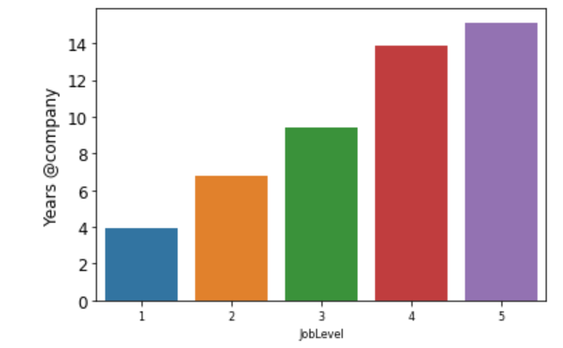
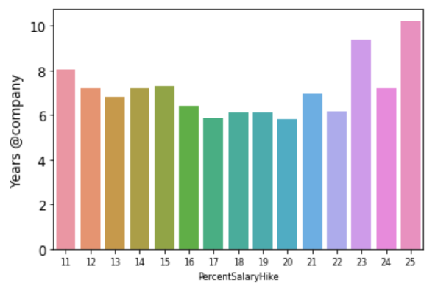


Years at Company

Slide 21
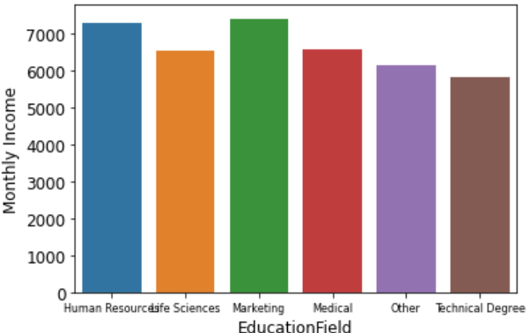
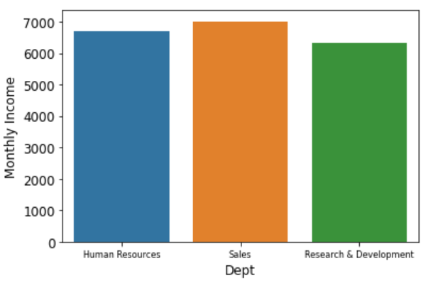
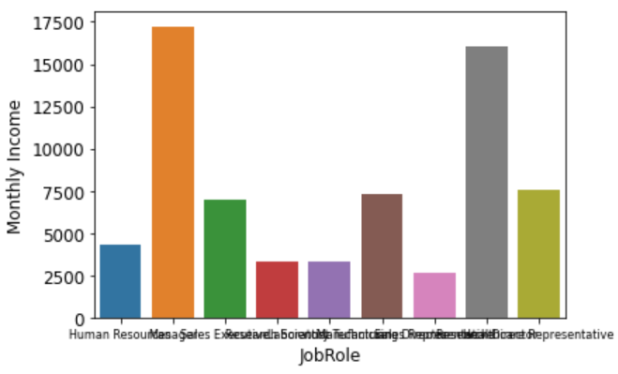
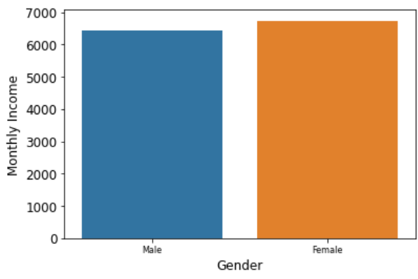
Monthly Income Distribution

Slide 22
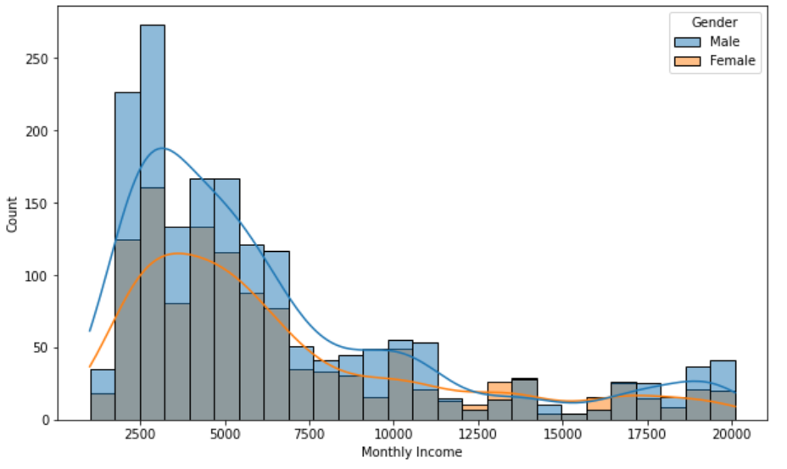
Distribution of Monthly Income vs Gender
KS Statistic = 0.06550412596665979 with a probability of 0.010789607030944004
Reject Null-Hypothesis. “Women and men are paid differently”

Slide 23
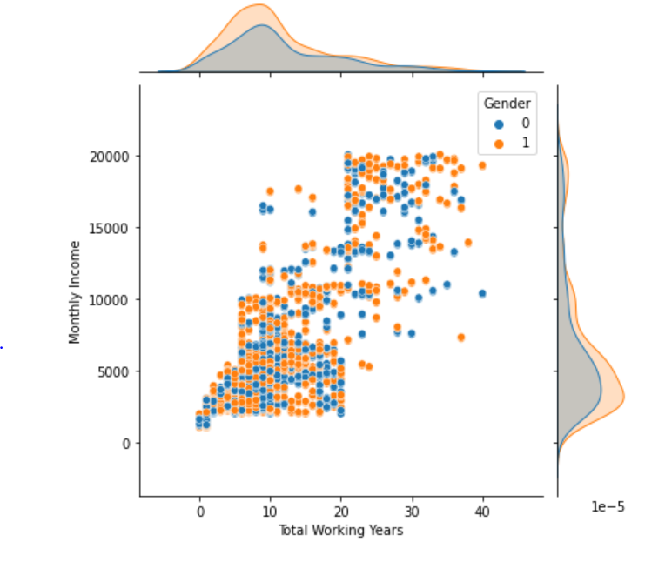
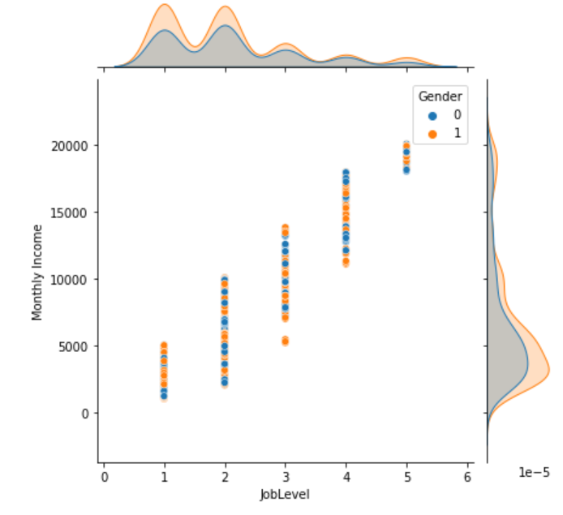
Total Working Years and Job Level have more impact on Monthly Income

Slide 24
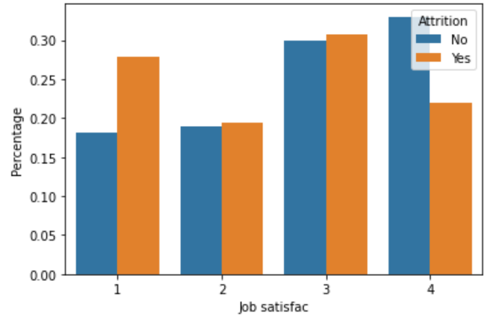
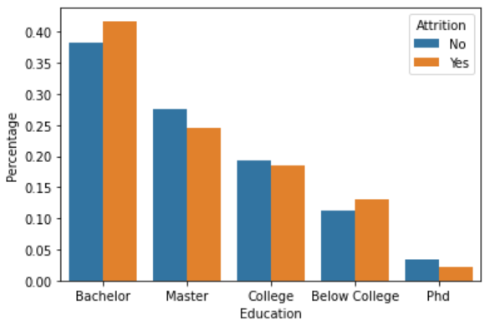
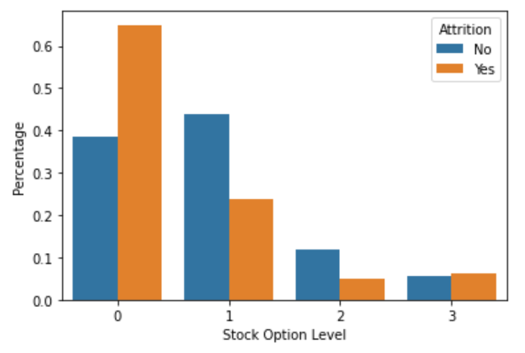
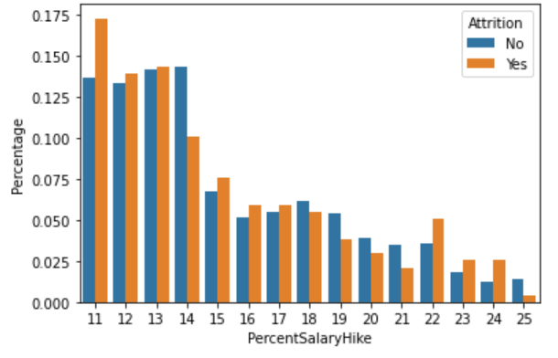
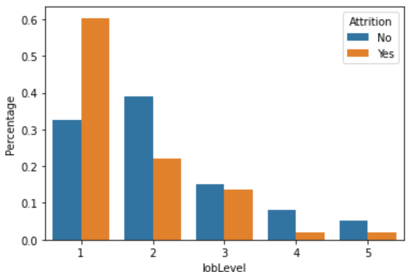
Attrition Analysis

Slide 25
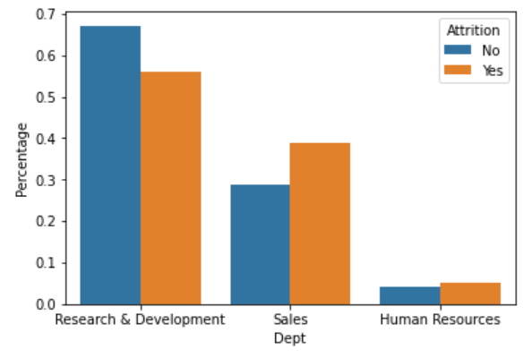
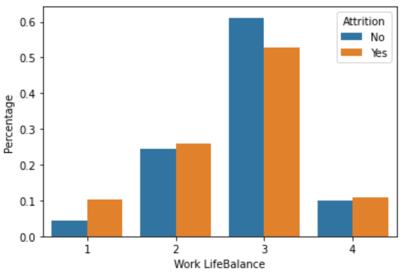
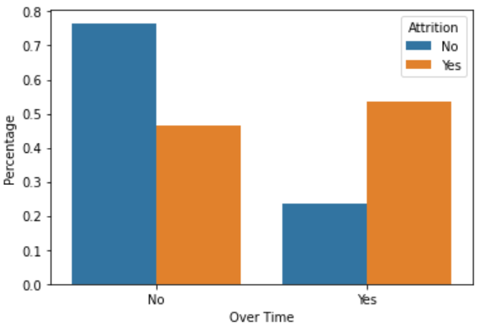
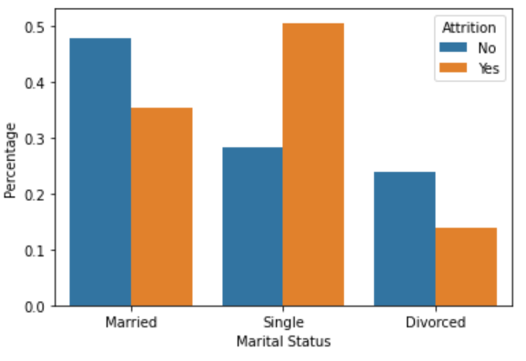
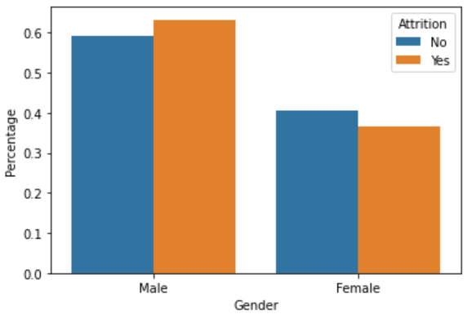

Slide 26
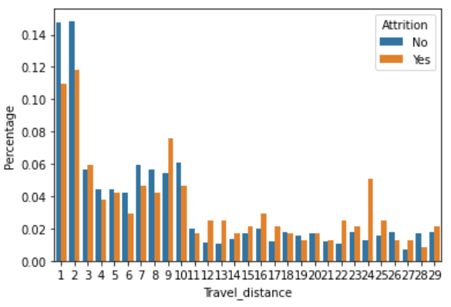
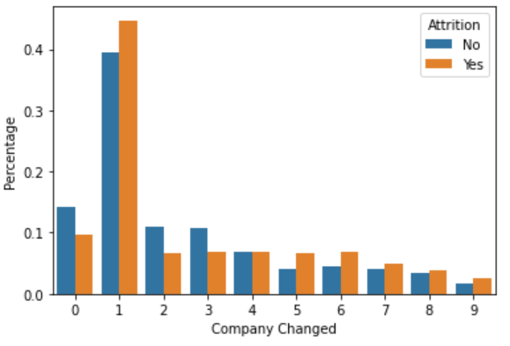
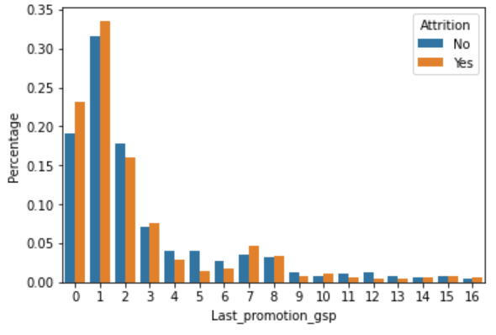
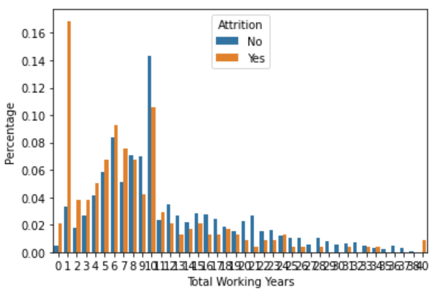
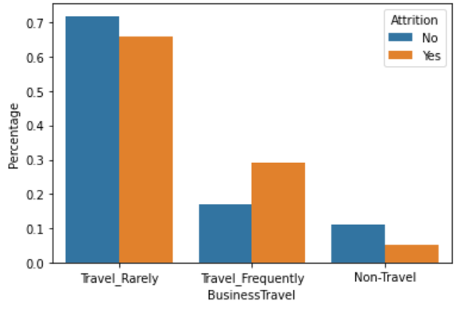

Slide 27
Multivariate Analysis
HR Attrition Analysis

Slide 28
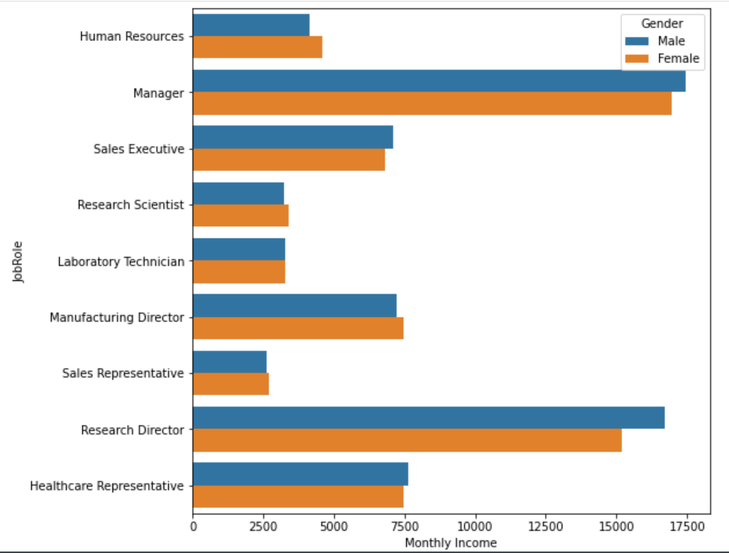
Monthly Income and Job Role with Gender
Managers and Research Directors have higher income compared to other Job Roles
Females are less paid in Higher income Job Roles
Also, Females are paid lesser for the role of Sales Executive

Slide 29
Feature Engineering & Data Preparation
HR Attrition Analysis

Slide 30
Feature Engineering
Derived Feature:
Environment Satisfaction, Job Involvement, Job satisfaction, Relationship Satisfaction were combined into Single Column named Combined Satisfaction.
Invariability in data point:
Employee ID ,Standard Hours and 18Yrs are dropped
Up Sampling:
The data has imbalanced target variable with higher percentage of ‘No’. Resample() from sci-kit learn is used to make equal number of ‘Yes’ and ‘No’

Slide 31
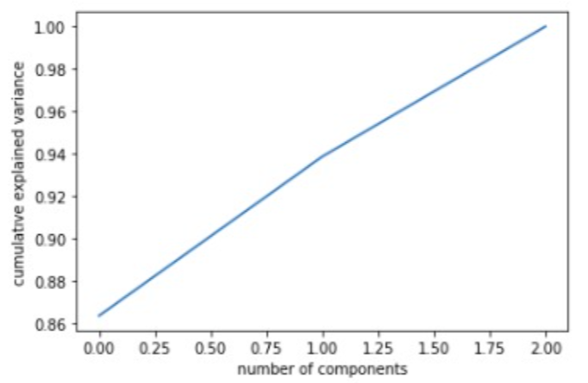
Feature Engineering
Principle Component Analysis:
Years @current Manager, Years @company, Years @current role reduced into one dimension by performing PCA
Explained Variance Ratio: 0.9385

Slide 32
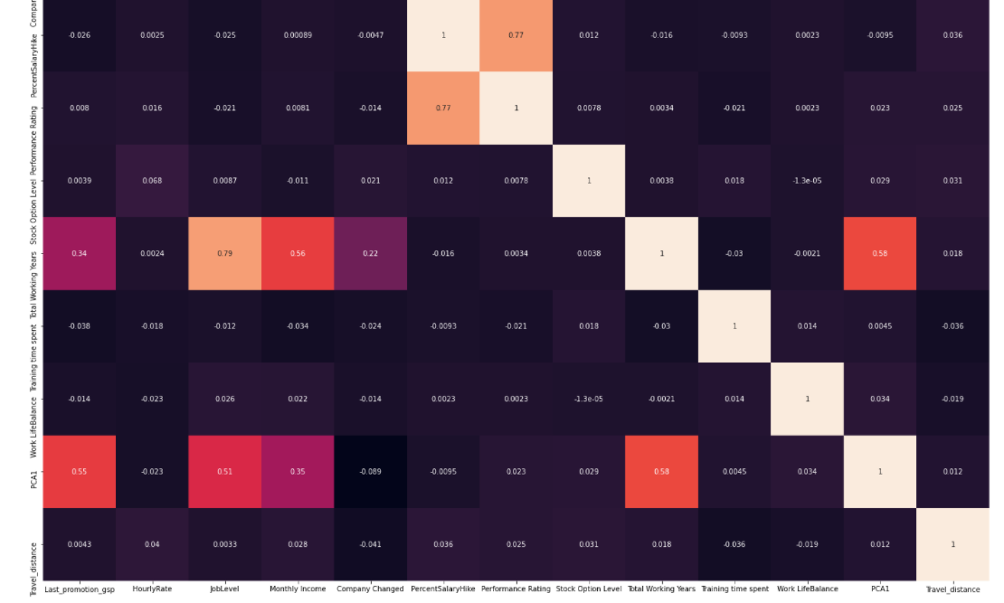
Feature Engineering
Multi Collinearity
Remove features whose correlation value is more than 0.8 because those features lead to multi collinearity and these can lead to high variance in the model. So, the features are-
Total Working Years: 0.79(approx.'0.80) with
All other variables seems to have correlation less than 0.80

Slide 33
Data Preparation
The data is mutated into three data sets:
data: The taw data with no feature engineering and outliers treatment done on it.
data_Feature_Engineered: The data with feature engineering and outliers treatment done.
data_up: Data after up-sampling

Slide 34
Hypothesis Testing
HR Attrition Analysis

Slide 35
Summary of hypothesis testing statements
No. | Null Hypothesis statements | Accept/Reject
1 | None of the derived features contribute to predict customer churn | Reject
2 | As the hourly rate increases attrition increases | Reject
3 | Employees of Total Working Years =< 2 have higher chances of leaving the organization. | Accept
4 | Research Department receive higher Monthly Income because of Over Time | Reject
5 | Higher Years at Company promotes Job Level | Accept

Slide 36
Performance Rating 9.405487e-01
HourlyRate 9.350892e-01
BusinessTravel 7.850363e-01
Gender 6.460823e-01
EducationField 4.559012e-01
Work LifeBalance 1.569896e-01
Dept 1.284021e-01
PercentSalaryHike 1.237231e-01
Education 3.442968e-02
Training time spent 3.378247e-03
Company Changed 1.147924e-03
Last_promotion_gsp 9.672003e-04
JobRole 2.089445e-04
Marital Status 5.379914e-07
Stock Option Level 1.349744e-08
JobLevel 9.107439e-10
Comb_Satisfaction 8.815687e-12
Over Time 5.267106e-27
Travel_distance 2.115041e-37
PCA1 1.638128e-61
Monthly Income 3.405045e-82

Slide 37
Predictive Modelling and Evaluation
HR Attrition Analysis

Slide 38
Xg Boost
We built Full Xg Boost model using capstone_csv.csv dataset.
Xg Boost is an implementation of gradient boosted decision trees designed for speed and performance.
Why Xg Boost?
Handles outliers(if any) by essentially binning them.
It has methods for balancing error in class population unbalanced data sets.
It is also indifferent to non-linear features.
Efficient easy to measure the relative importance of each feature on the prediction.

Slide 39
Random Forest Model has been implemented on the data as a base-line model before implementing Xg Boost.
In addition to Xg Boost, we will also implement Logistic Regression and compare the results attained.
Limitation of Logistic Regression:
The major limitation of Logistic Regression is the assumption of linearity between the dependent variable and the independent variables.
Highly sensitive to outliers and skewness.

Slide 40
Run Xg Boost/Random Forest/ Logistic Regression models on Train and Test data

Slide 41
Column1 | train_accuracy | test_accuracy | train recall | test recall | train auc | test auc
RF basic | 93.2 | 83.4 | 64.8 | 21.8 | 82.1 | 60.2
RF_fea_eng | 100 | 83.2 | 100 | 26.43 | 100 | 61.8
RF_up | 100 | 82.53 | 100 | 17.24 | 100 | 57.91
XG_basic | 93.75 | 83.44 | 61 | 29 | 80.37 | 62.81
XG_fea_eng | 93.19 | 84.8 | 61 | 34 | 78.66 | 65.83
XG_fea_up | 91.21 | 80.72 | 90.9 | 51.11 | 91.21 | 70.22
LR_basic | 88.43 | 83.44 | 39.27 | 25.28 | 68.35 | 61.51
LR_fea_eng | 88.03 | 24.2 | 34.36 | 100 | 50.706 | 66.11
LR_fea_up | 77.29 | 26.1 | 78.5 | 100 | 77.27 | 50.56

Slide 42
Hyper-parameters tuning
Random Forest :
RandomizedSearchCV
GridSearchCV
XG Boost :
GridSearchCV with param grid

Slide 43
Random Forest : RandomizedSearchCV
GridSearchCV
Column1 | train_accuracy | test_accuracy | train recall | test recall | train auc | test auc
RF basic | 93.2 | 83.4 | 64.8 | 21.8 | 82.1 | 60.2
RF_rand_search | 92.45 | 84.32 | 63.11 | 25.28 | 80.26 | 62.07
RF_fea_eng | 100 | 83.2 | 100 | 26.43 | 100 | 61.8
RF_fea_eng_rand_search | 100 | 83.4 | 100 | 27.58 | 100 | 62.38
RF_fea_eng_grid_search | 96.95 | 82.53 | 80.36 | 16.09 | 89.54 | 57.48
RF_up | 100 | 82.53 | 100 | 17.24 | 100 | 57.91
RF_fea_up_rand_search | 100 | 82.08 | 100 | 11.49 | 100 | 55.46
RF_fea_up_grid_search | 99.9 | 85.03 | 100 | 29.88 | 100 | 64.23

Slide 44
XG Boost :
GridSearchCV with param grid
Column1 | train_accuracy | test_accuracy | train recall | test recall | train auc | test auc
XG_basic | 93.75 | 83.44 | 61 | 29 | 80.37 | 62.81
XG_fea_eng | 93.19 | 84.8 | 61 | 34 | 78.66 | 65.83
XG_fea_grid_param | 100 | 86.16 | 100 | 44.82 | 100 | 70.57
XG_fea_up | 91.21 | 80.72 | 90.9 | 51.11 | 91.21 | 70.22
XG_fea_up_grid_param | 100 | 82.31 | 100 | 66.66 | 100 | 76.41

Slide 45
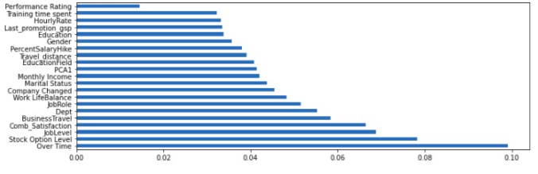
Xg Boost GridSearchCV with param grid on feature engineered data
Column1 | train_accuracy | test_accuracy | train recall | test recall | train auc | test auc | update
XG_fea_eng | 93.19 | 84.8 | 61 | 34 | 78.66 | 65.83 | -
xg_fea_grid_step1 | 100 | 85.03 | 100 | 34.44 | 100 | 65.97 | -
xg_fea_grid_step2 | 100 | 82.99 | 100 | 20.68 | 100 | 59.4 | max_depth=7,min_child_weight=0
xg_fea_grid_step3 | 100 | 83.6 | 100 | 28.7 | 100 | 62.9 | gamma=0.1
xg_fea_grid_step4 | 100 | 85.26 | 100 | 40.22 | 100 | 68.27 | colsample_bytree=0.75,subsample=0.55,reg_alpha=0.0001
xg_fea_grid_step5 | 100 | 85.71 | 100 | 42.52 | 100 | 69.42 | reg_lamba=0.001
xg_fea_grid_step6 | 100 | 86.16 | 100 | 44.82 | 100 | 70.57 | learning_rate=0.1,n_estimators=3500
Confusion Matrix | Actual-Yes | Actual-No
Predicted -Yes | 39(TP) | 48(FP)
Predicted- No | 13(FN) | 341(TN)

Slide 46
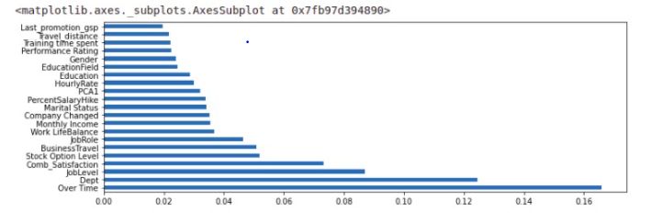
Xg Boost GridSearchCV with param grid ered data
Column1 | train_accuracy | test_accuracy | train recall | test recall | train auc | test auc | update
XG_fea_up | 91.21 | 80.72 | 90.9 | 51.11 | 91.21 | 70.22 | -
xg_fea_up_grid_step1 | 91.64 | 82.99 | 92.04 | 49.42 | 91.64 | 70.33 | -
xg_fea_up_grid_step2 | 90.87 | 81.47 | 91.29 | 49.98 | 90.84 | 70.78 | max_deapth=2,min_child_weight=0
xg_fea_up_grid_step3 | 85.89 | 82.31 | 85.41 | 65.51 | 85.62 | 75.97 | gamma=0
xg_fea_up_grid_step4 | 85.6 | 82.32 | 85.7 | 66.66 | 85.41 | 76.41 | colsample_bytree=0.75,subsample=0.7,reg_alpha=0.0001
xg_fea_up_grid_step5 | 85.6 | 82.31 | 85.7 | 66.66 | 85.41 | 76.41 | reg_lamba=0.05
xg_fea_up_grid_step6 | 100 | 82.31 | 100 | 66.66 | 100 | 76.41 | learning_rate=0.1,n_estimators=100
Confusion Matrix | Actual-Yes | Actual-No
Predicted -Yes | 58(TP) | 49(FP)
Predicted- No | 29(FN) | 305(TN)

Slide 47
Feature Importance of Xg Boost Model
Based on the chart, we can con conclude that Stock Option Level, Over Time, Job Level play an important role followed by Comb_Satisfaction in deciding attrition of an employee.
On the other hand Education, Performance Rating, Gender and Training time spent tends to contribute minimal.

Slide 48
Conclusion and Recommendations
HR Attrition Analysis

Slide 49
Conclusions
Organization’s attrition rate is 16.3% which is higher than industrial average attrition(10%).
On noticing the patterns, top factor for employee attrition in this organization seems to be monetary, as Over Time and Stock Option Level are the factors mostly driving attrition.
The next important factor seems to psychological features be:
Relationship Satisfaction with fellow workers, where current manager and job role could be the main contributing reasons for attrition.
Job Involvement is a critical satisfaction factor, employees who are more involved are less likely to leave the organization.

Slide 50
Conclusions
Employees who has done only Bachelors as Education, has Job Level = 1 and has Total Working Years =< 2 have higher chances of leaving the organization.
Pursuing longer years in the company, employees tend to promoted to higher level and have lesser attrition rate.
Sales Department employees has higher attrition rate which should be taken care of because it has direct impact on customer loss and customer relationships.
Work Life Balance has little to less impact on attrition in this organization. Surprising!!

Slide 51
Recommendations
To retain the employees HR should focus on the above conclusions and understand from the employee viewpoint.
Provide competitive benefits and Perks.
Organization should keep employees constantly involved and motivated. Especially Sales Department.
Keep employees engaged with other fellow employees.
The model needs to be tuned from time to time as when new data set is received.

Slide 52
Future Enhancements to the Model
The feature Performance Rating has been restricted to scores of 3 and 4 only. More insights could be generated if the full spectrum of performance ratings are included.
With the help of H.R team, A new feature ‘EduField_Job’ is created which defines whether Job Role is related to Education Field, with the labels ‘0’ = not related, ‘1’ = related, ‘2’ = somewhat related. This might give us an understanding of attrition in different perspective.
Feeding with more data would strengthen the model.

Slide 53
Thank You

